Slide 1
API Security Essentials
Ishaan Malik

Slide 2
API Security Essentials
Web API security essentials center around protecting endpoints from unauthorized access, data leaks, and abuse by securing the application layer.
Because APIs expose underlying application logic and data directly, securing them requires moving beyond traditional network perimeters to robust, identity-centric verification.

Slide 3
Authentication vs Authorization (IAM)
The core difference lies in verifying who you are (Authentication) or what you are allowed to do (Authorization).
Concept | Definition | Analogy | API Implementation
Authentication | Verifying the identity of a user or service. Proving you are who you claim to be. | Presenting your passport or ID at an airport checkpoint. | Verifying a username/password, validating a JWT signature, or checking an API Key.
Authorization | Verifying the permissions of an authenticated identity. Determining if you have access to a resource. | Looking at your boarding pass to see if you are allowed in First Class or the cockpit. | Checking database permissions, RBAC (Role-Based Access Control), or checking if a user owns a specific resource ID.

Slide 4


Slide 5
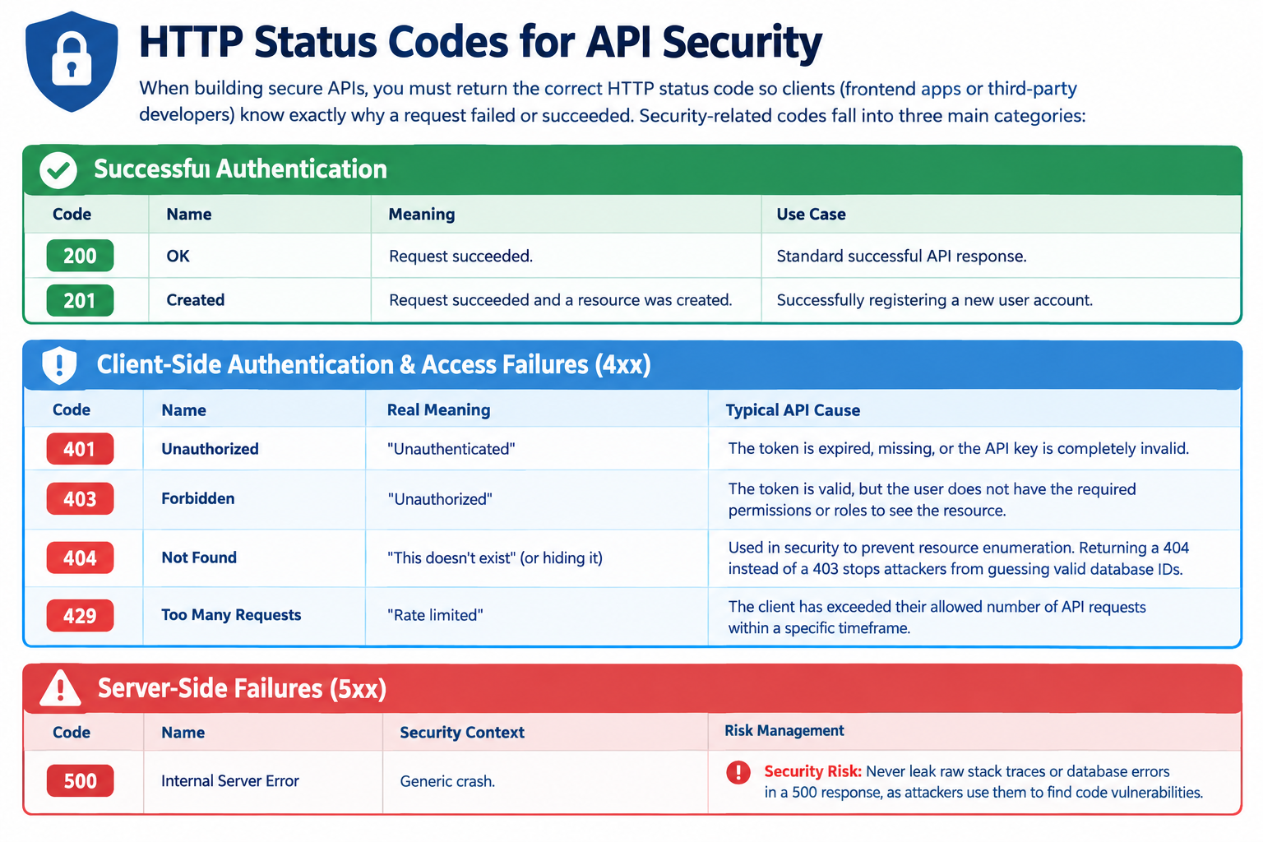

Slide 6
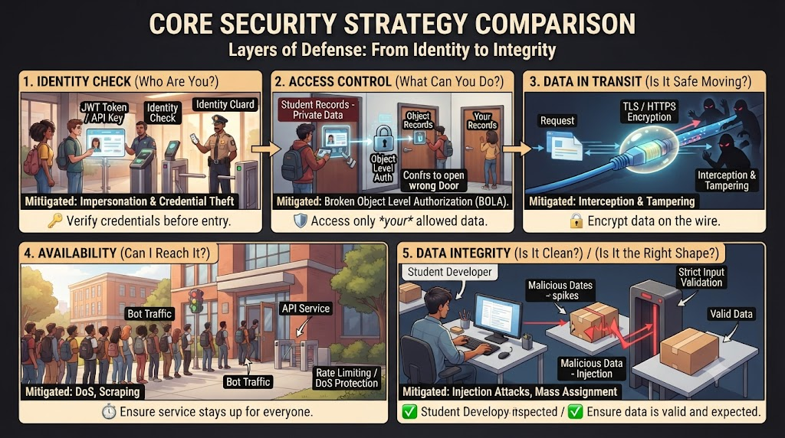

Slide 7
Password Hashing Concepts
When a user creates an account, an API should never store the password in plaintext. If the database is compromised, every user account becomes vulnerable.
Instead, systems use cryptographic hashing to mask the password permanently.
A hash is a one-way scramble: you can turn a password into a hash, but you can't turn the hash back into the password.

Slide 8
Key Mechanics of Password Hashing
One-Way Function: Hashing transforms a string of text into a unique, fixed-length string of characters (a hash). This mathematical process is mathematically irreversible—you cannot reverse-engineer the hash to find the original password.
Deterministic Output: The same input will always generate the exact same hash. When a user logs in, the API hashes the incoming password and compares it directly to the stored hash.
The "Salt" Requirement: If two users use the password Password123!, they would naturally have identical hashes, allowing attackers to crack multiple accounts simultaneously using pre-computed tables (Rainbow Tables). To prevent this, systems append a Salt—a unique, cryptographically random string—to the password before hashing it. This ensures every stored hash remains completely unique, even for identical passwords.
Key Stretching / Cost Factors: Modern hashing algorithms are intentionally engineered to be slow. This computational lag prevents brute-force automation from guessing millions of password combinations per second.

Slide 9
JWT Token
A JWT (JSON Web Token) is a signed string the server hands out after login. The client sends it back on each request. A JWT has three parts separated by dots:
Header: says it's a JWT and which algorithm signed it, for example HMAC SHA-256.
Payload: Contains the actual data. E.g. Claims about the user (e.g., userId, roles) along with expiration metadata (exp, iat).
Signature: the header and payload signed with a secret key that only the server knows. It stops anyone from changing the token.
xxxxx.yyyyy.zzzzz
header.payload.signature

Slide 10
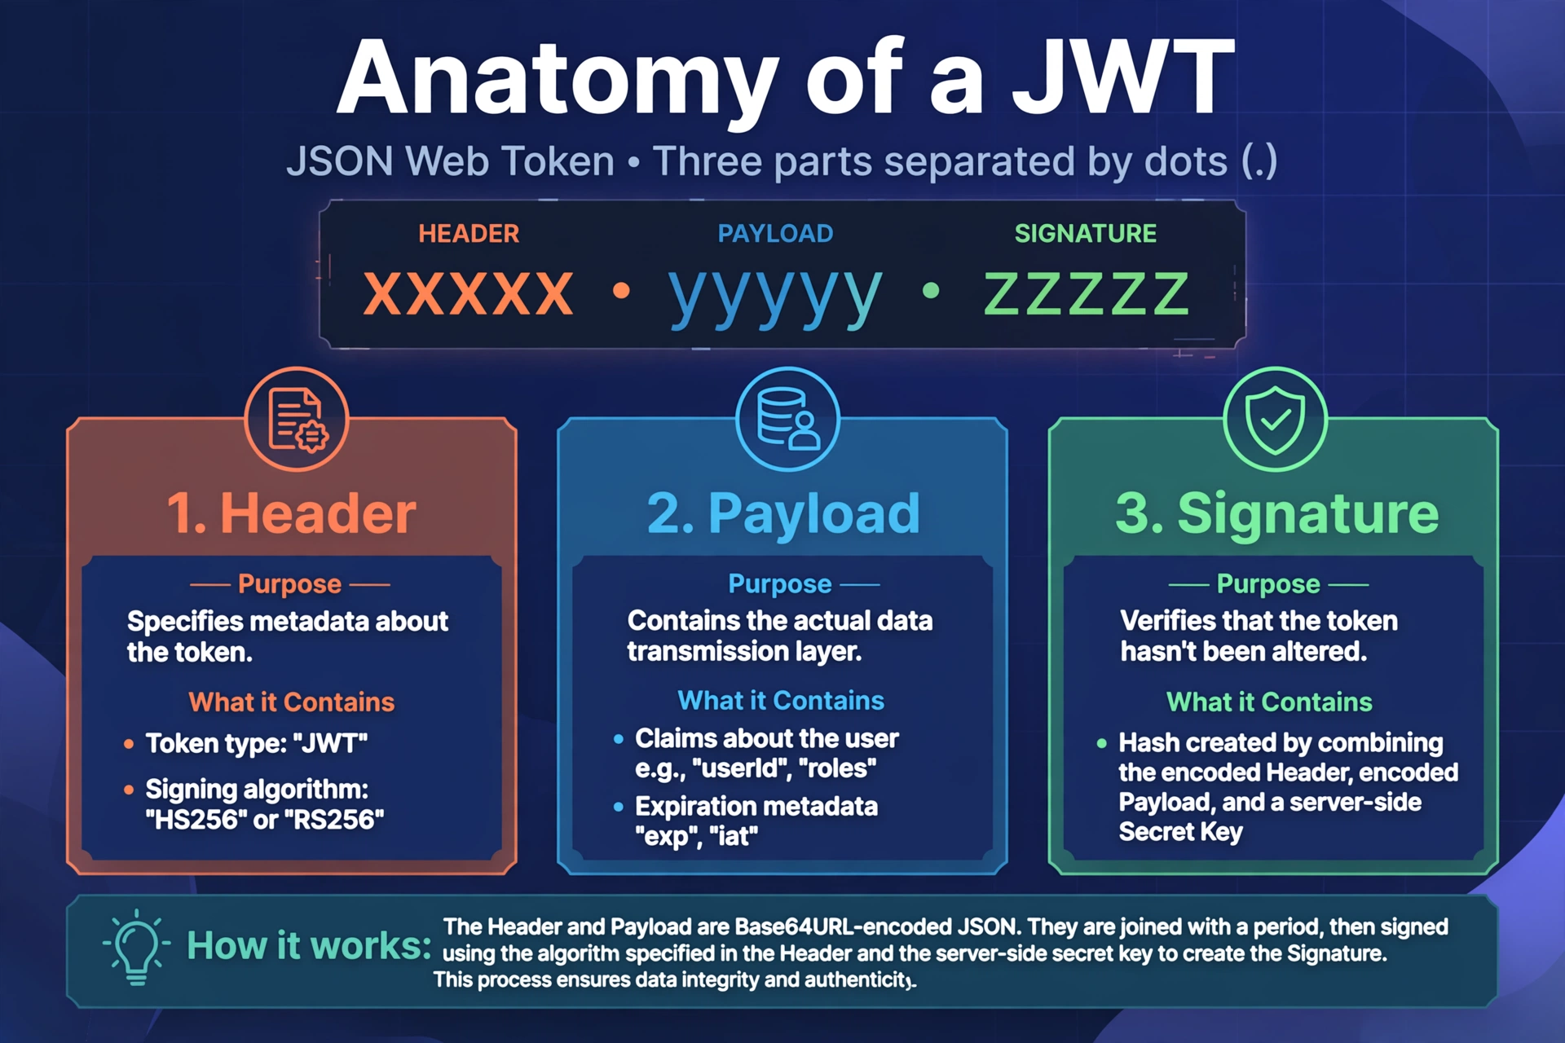

Slide 11
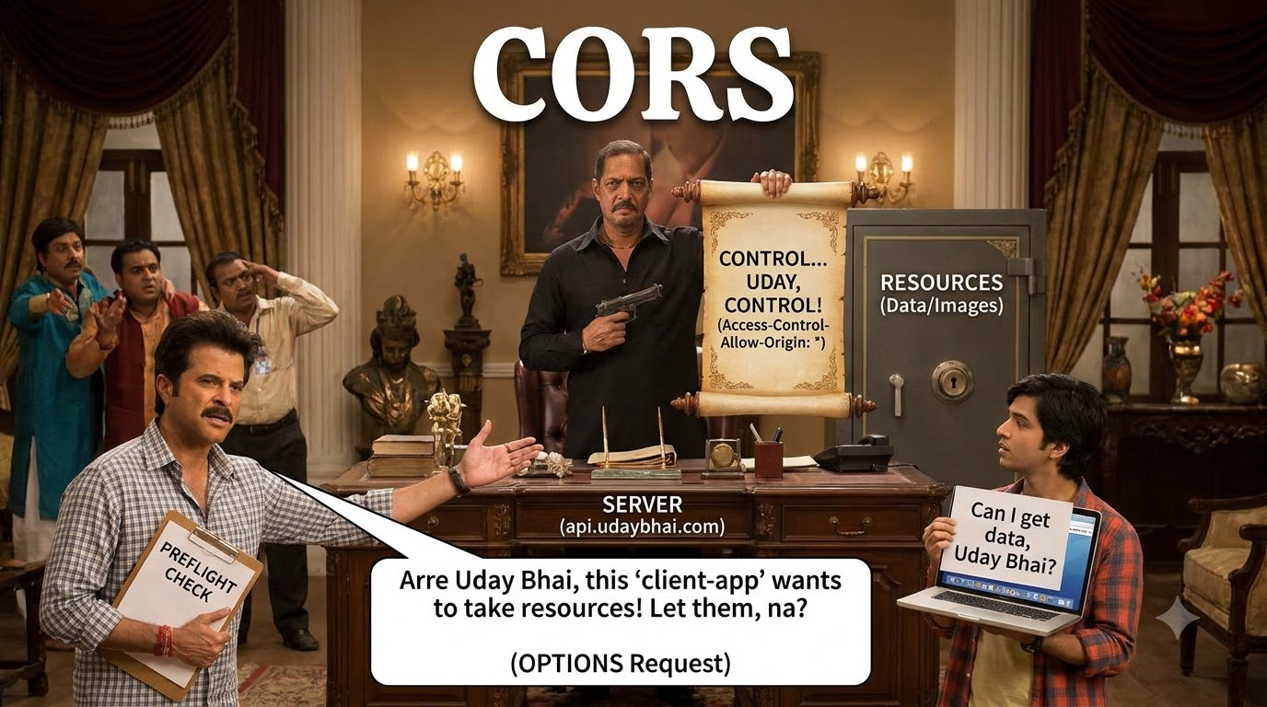

Slide 12


Slide 13
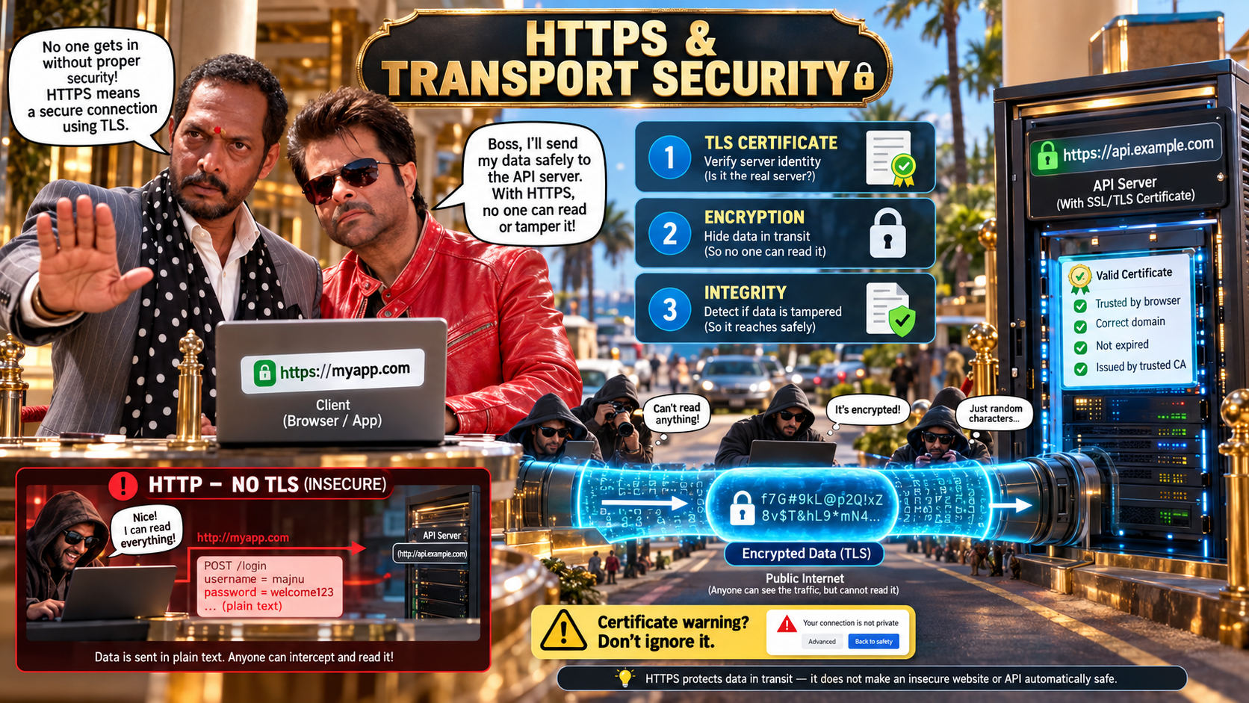

Slide 14


Slide 15
OWASP
OWASP (Open Worldwide Application Security Project) is a non-profit foundation that works to improve software security through community-led open-source projects, tools, and educational guides.
While the general OWASP Top 10 focuses broadly on web application risks.
OWASP also maintains a dedicated, separate OWASP API Security Top 10 tailored specifically to the unique vulnerabilities of APIs.

Slide 16
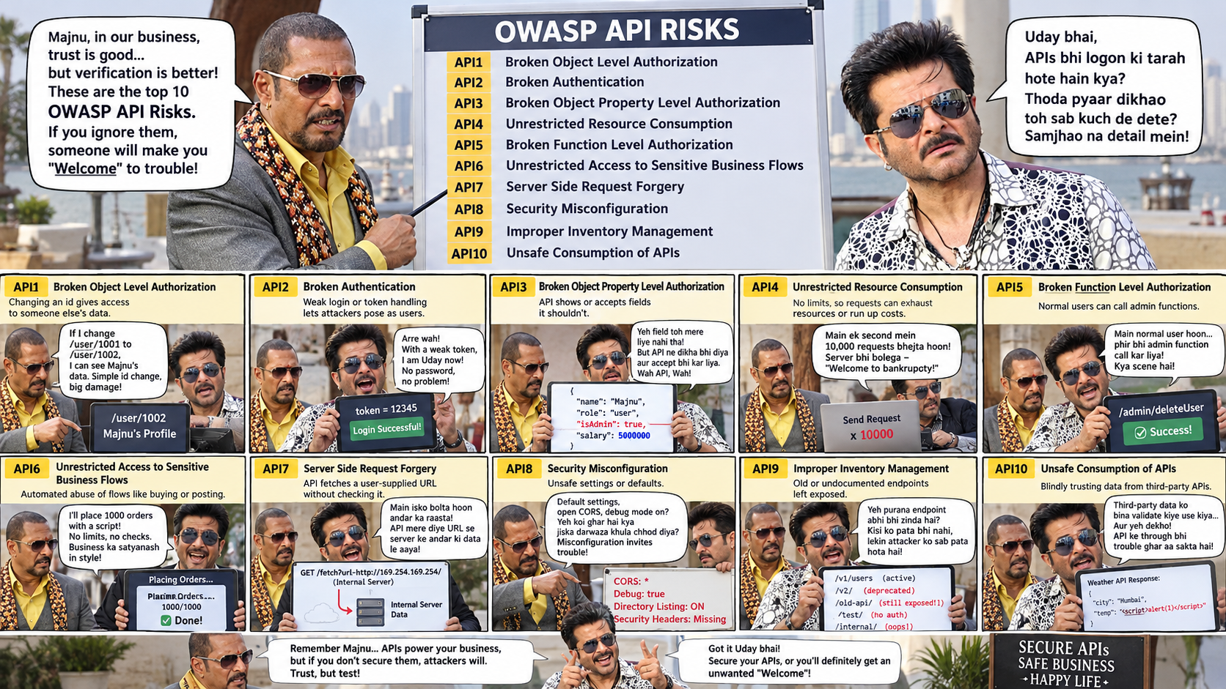

Slide 17
Quick Quiz
Which of the following best describes the fundamental difference between API authentication and authorization?
Authentication determines what resources a user can access, while authorization verifies who the user is.
Authentication and authorization are identical processes in modern microservices architectures.
Authentication verifies the identity of the client or user, whereas authorization determines what actions or resources that verified user is permitted to access.
Authorization always occurs prior to authentication in every stateless REST API request.
Answer: C

Slide 18
Quick Quiz
An API client makes a request to a protected endpoint without providing any credentials, such as an Authorization header. Which HTTP status code should the server return, and why?
401 Unauthorized, because the client has not provided valid authentication credentials to identify itself.
403 Forbidden, because the server understands the request but refuses to authorize it regardless of authentication.
405 Method Not Allowed, because the client used an incorrect HTTP verb.
400 Bad Request, because the payload is missing mandatory headers.
Answer: A

Slide 19
Quick Quiz
What are the three distinct components that make up a standard JSON Web Token (JWT), separated by dots?
Client ID, Secret, and Token Expiry
Username, Password Hash, and Permissions List
Issuer, Audience, and Signature Algorithm
Header, Payload, and Signature
Answer: D

Slide 20
Quick Quiz
How does Cross-Origin Resource Sharing (CORS) primarily protect web applications consuming APIs?
By encrypting the payload in transit between the browser and the API server.
By enforcing browser-level restrictions that allow a server to specify which external domains are permitted to access its resources via scripts.
By blocking SQL injection attempts coming from untrusted domains.
By completely disabling cookies for all cross-site requests.
Answer: B

Slide 21
Q&A
The End

